Slide 1
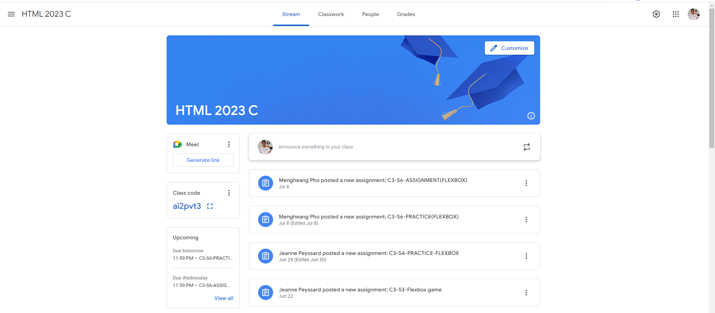
Identify root components of website below

Slide 2
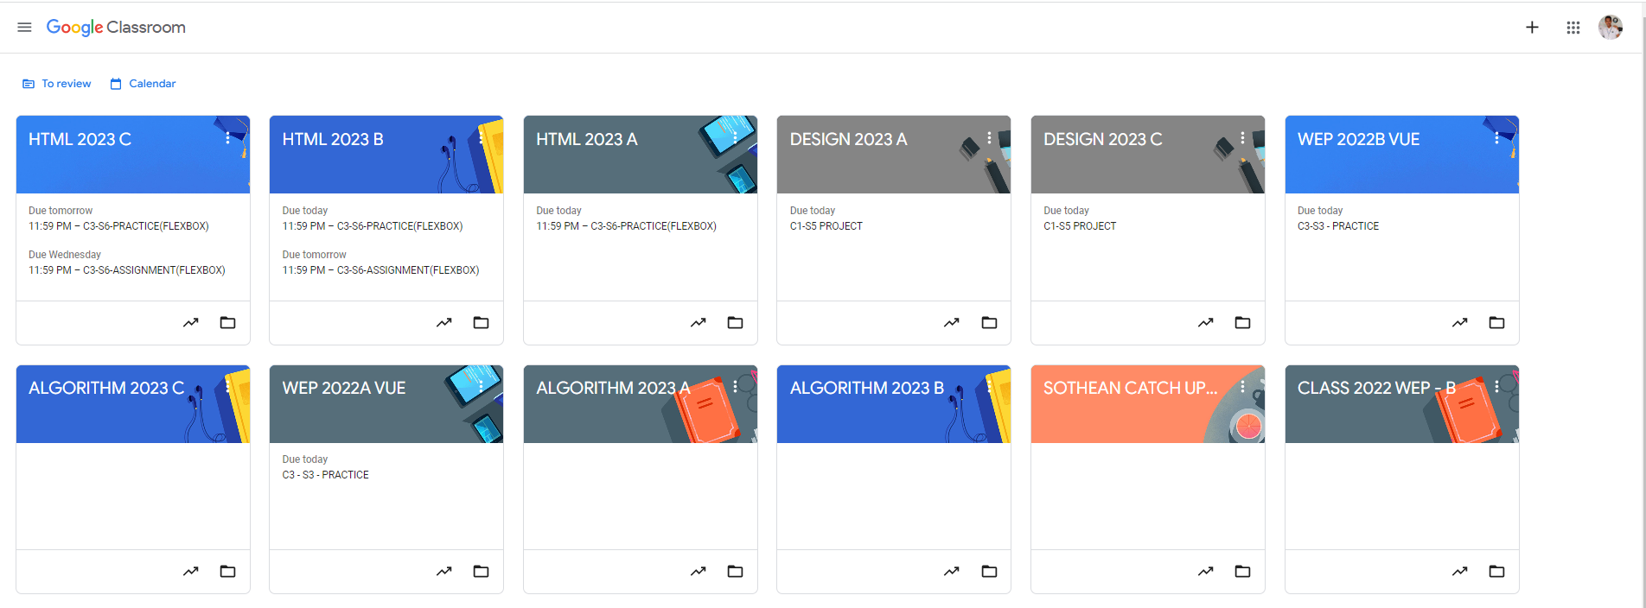
Root div
- Height: 100vh
content
nav
Flex: 0
header
Flex: 0
Flex: 1

Slide 3
Flex 0: Navigation
Flex 0: Header
Flex 1:Main

Slide 4
Navigation
Display: flex
Flex direction: row
Nav-left
Nav-center
Nav-right
Justify-content: space-evenly

Slide 5
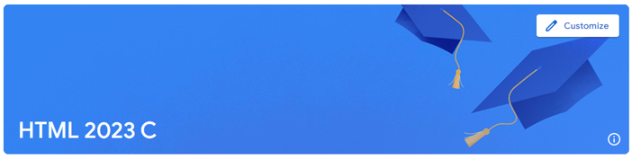
Header
Justify-content: flex-end
Top-header
Bottom-header
Align-items: flex-end
Justify-content: space-between

Slide 6
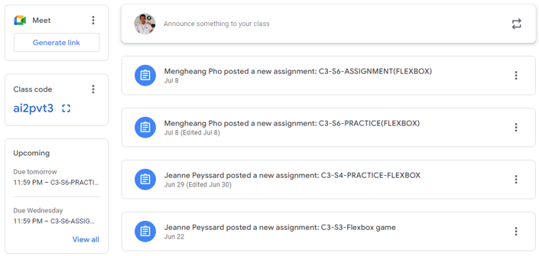
Main
Main-sidebar
Main-content
Display: flex
flex-direction: column
Display: flex
flex-direction: column

Slide 7
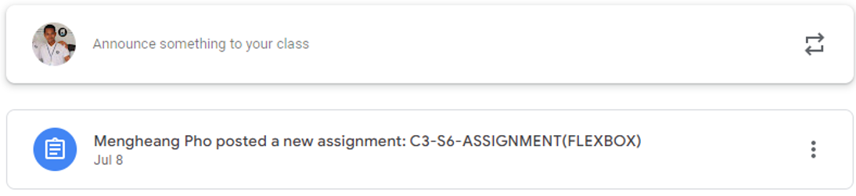
Display: flex
Flex-direction: row
item1
item2
item3
Justify-content: flex-start
Justify-content: flex-end

